Slide 1

Harnessing Core Facilities for Space Biology Research
Dr. Camilla Urbaniak
Biotechnology and Planetary Protection Group
NASA-Jet Propulsion Laboratory
Pasadena, California
camilla.urbaniak@jpl.nasa.gov

Slide 2

Mars Sample Return:
NASA and the European Space Agency are developing plans for one of the most ambitious campaigns ever attempted in space: bringing the first samples of Mars material safely back to Earth for detailed study. The diverse set of scientifically curated samples now being collected by NASA's Mars Perseverance rover could help scientists answer the question of whether ancient life ever arose on the Red Planet.
Planetary Protection is responsible for ensuring that all missions to planets or moons in our solar system that have the potential for life, or past life, are protected from biological contamination from Earth, in addition to preventing harm to Earth's environment from possible extraterrestrial life forms that are brought back.

Slide 3
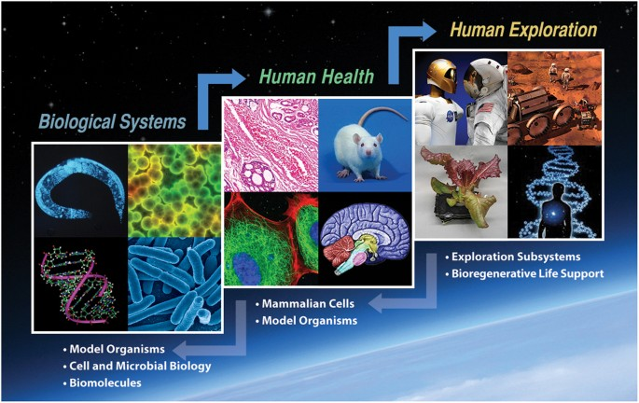
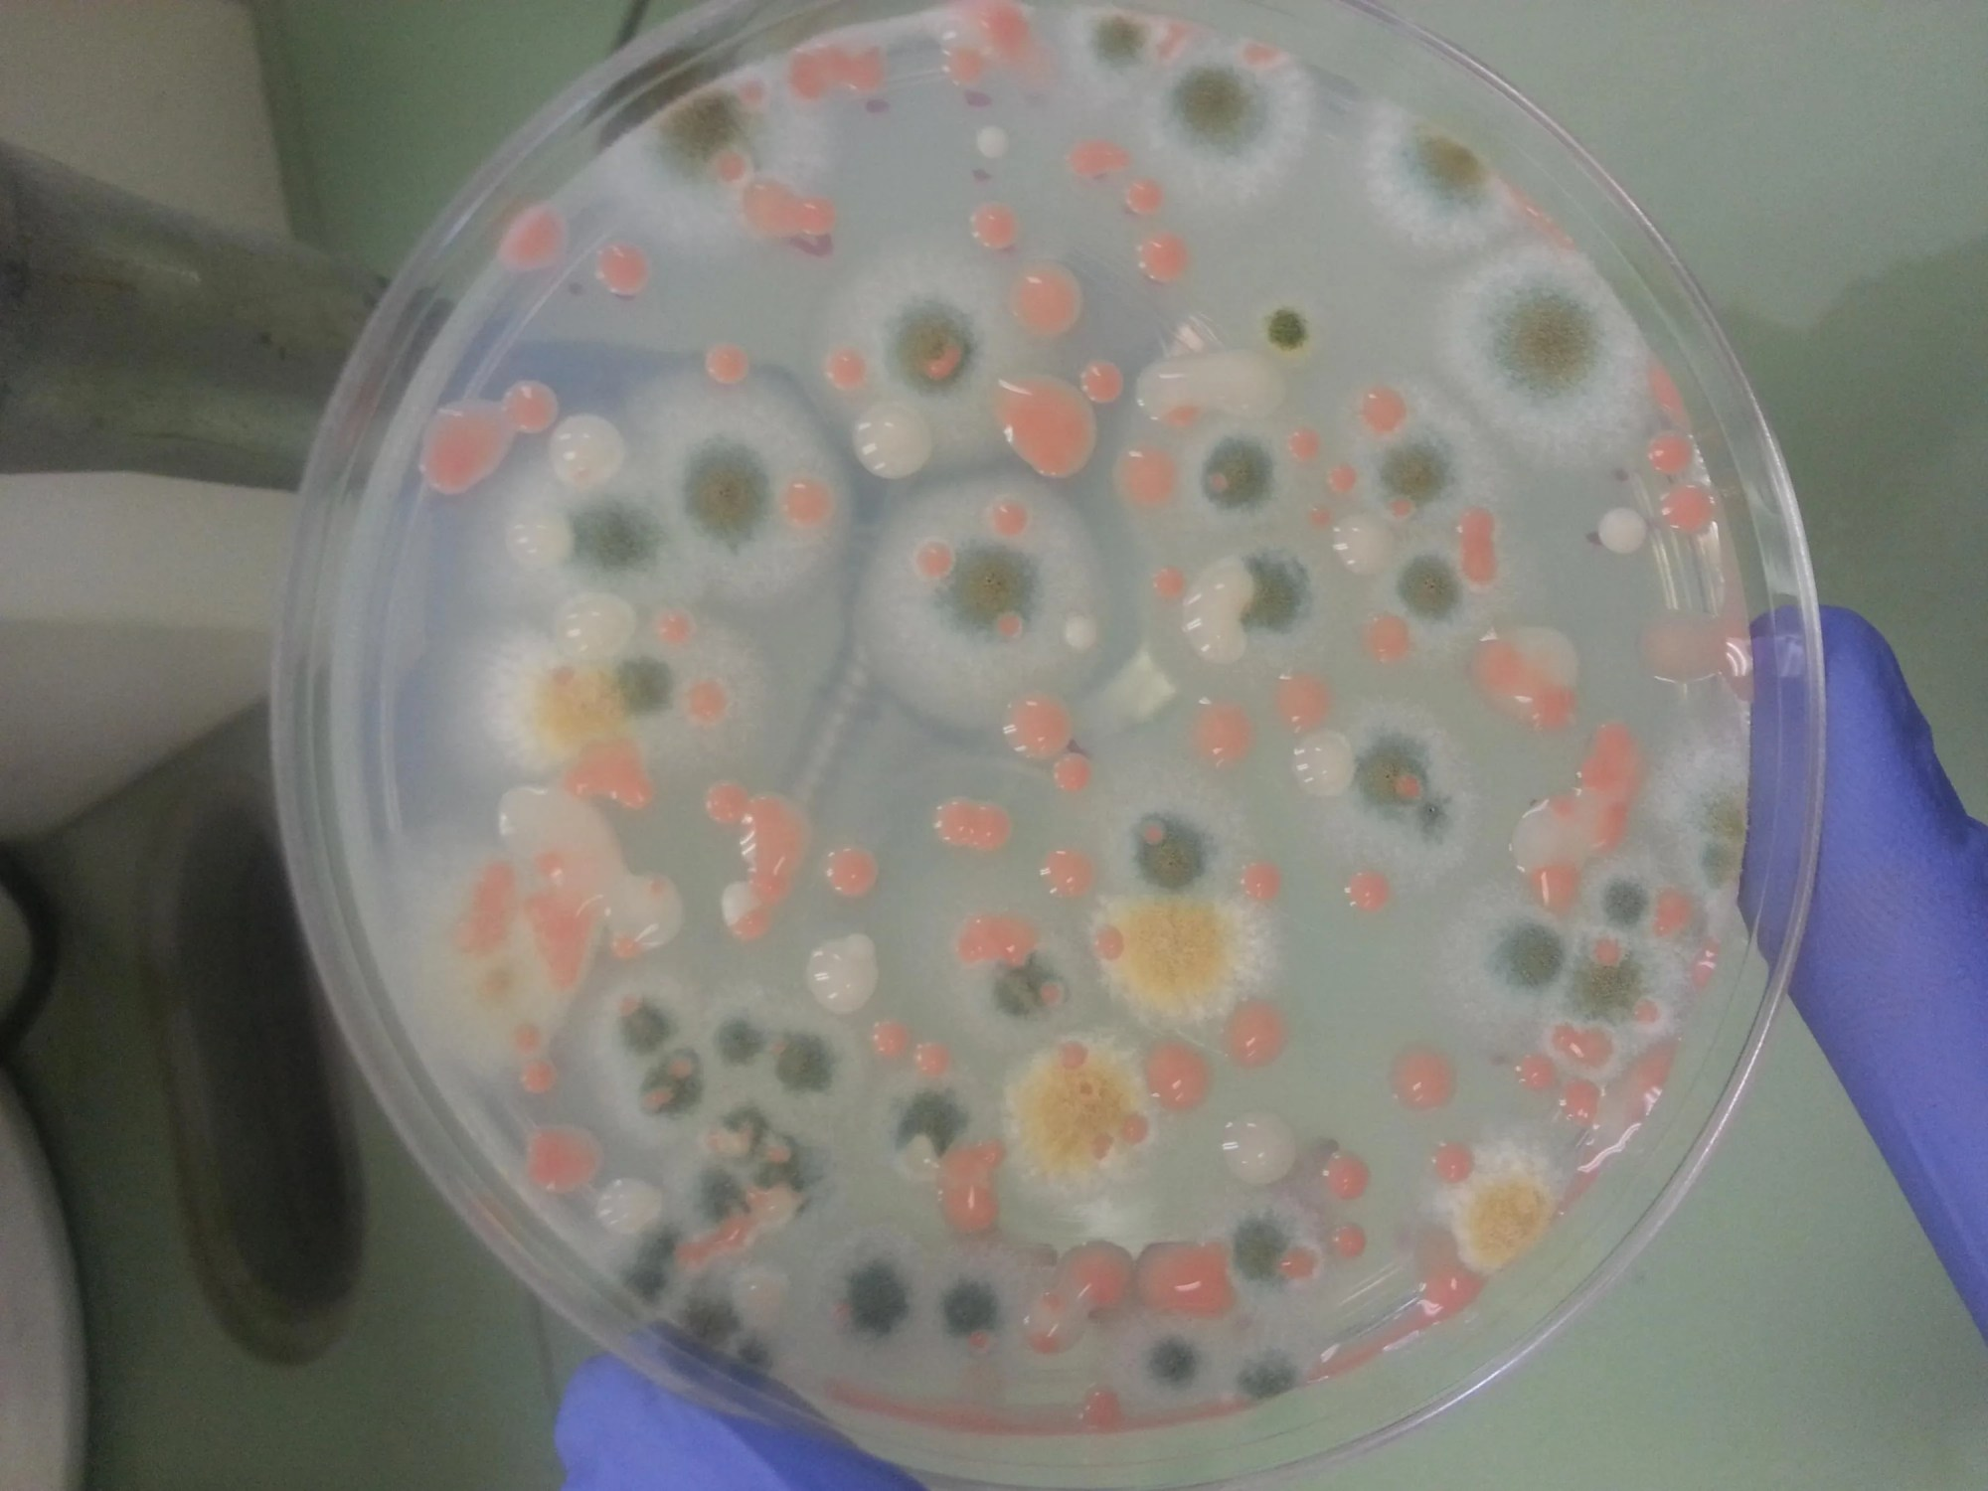
NASA SPACE BIOLOGY PROGRAM
OUR GROUP:
Microbes
Cultures of samples collected from ISS surfaces
We perform research to understand how microbes adapt to the space environment, how microbes affect astronaut health, and how microbes can aid in sustainable human exploration beyond low earth orbit
The NASA Life Sciences Translational Path. It moves from basic research to human exploration applications with bi-directionality options. As knowledge is applied along this path (top arrows) questions may arise that can best be addressed by more basic research (bottom arrows) in order to support further progress toward successful human exploration

Slide 4
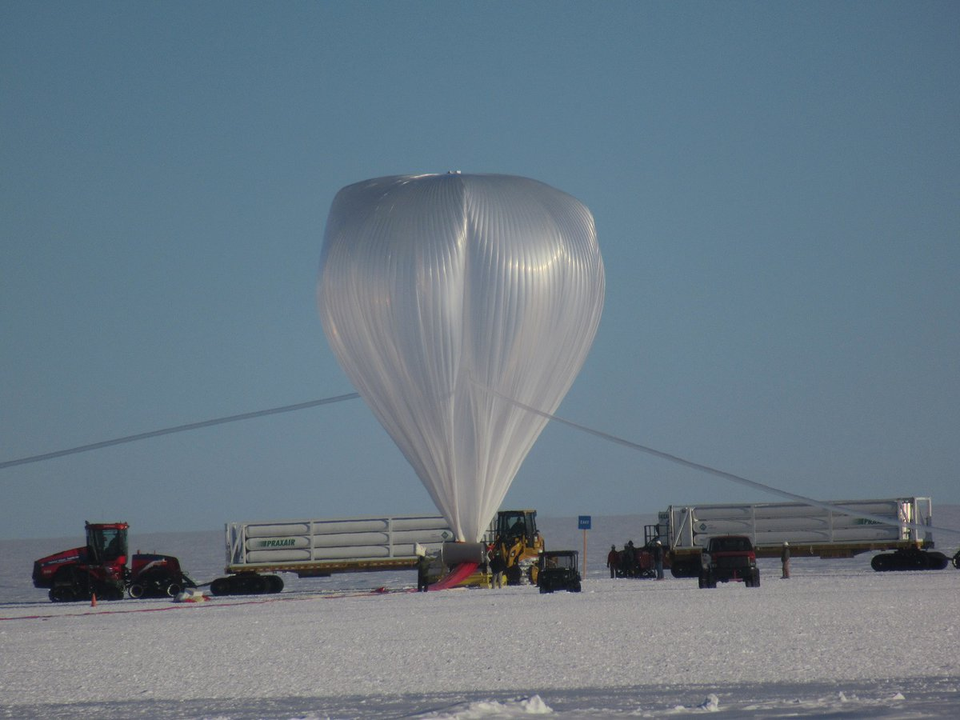
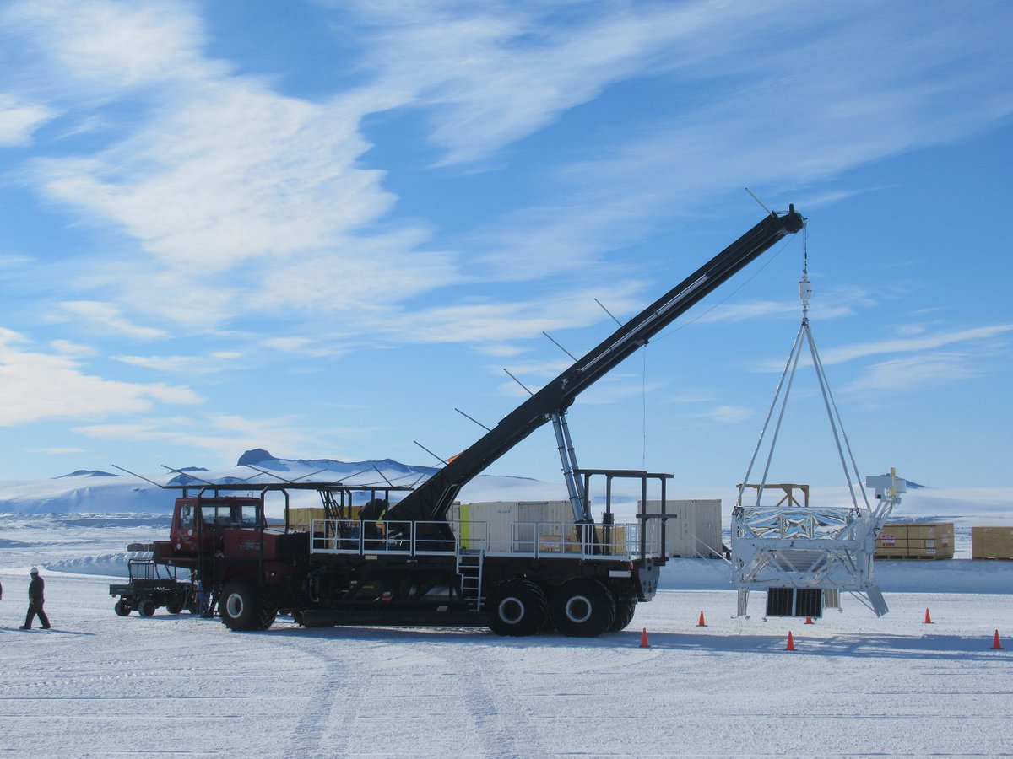
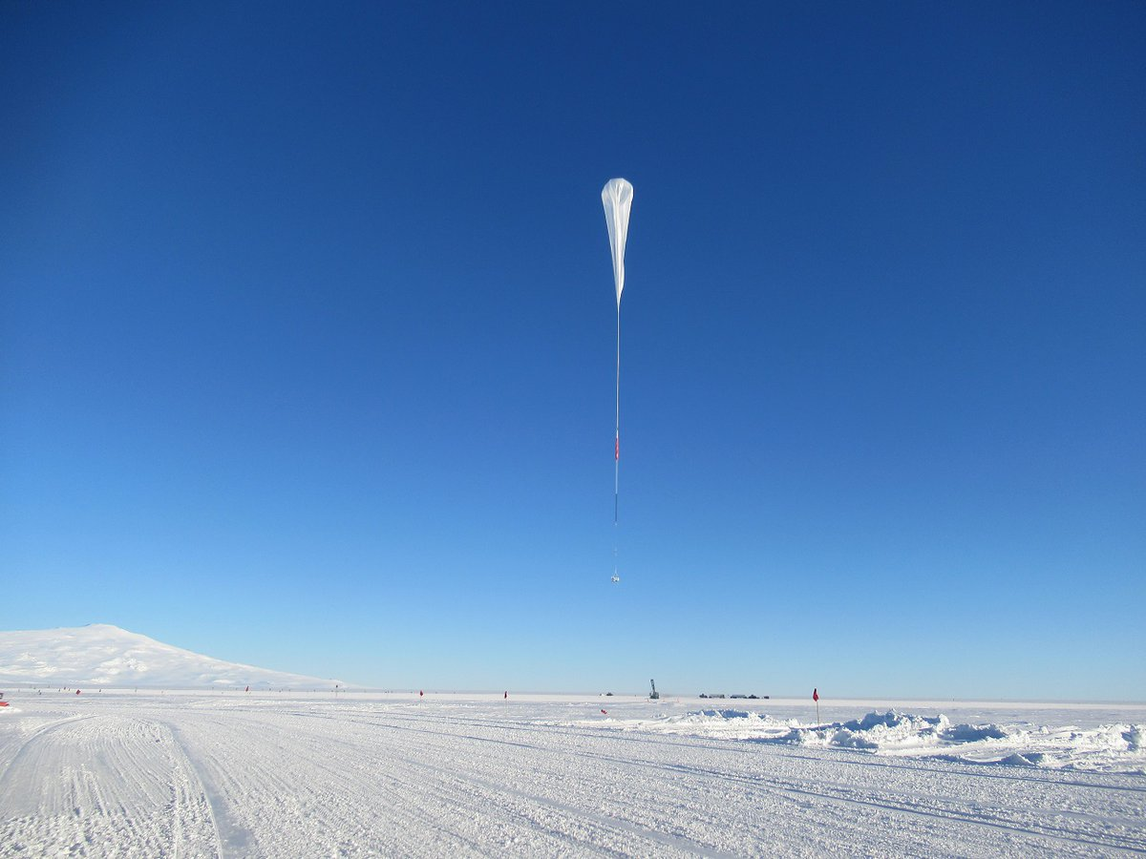
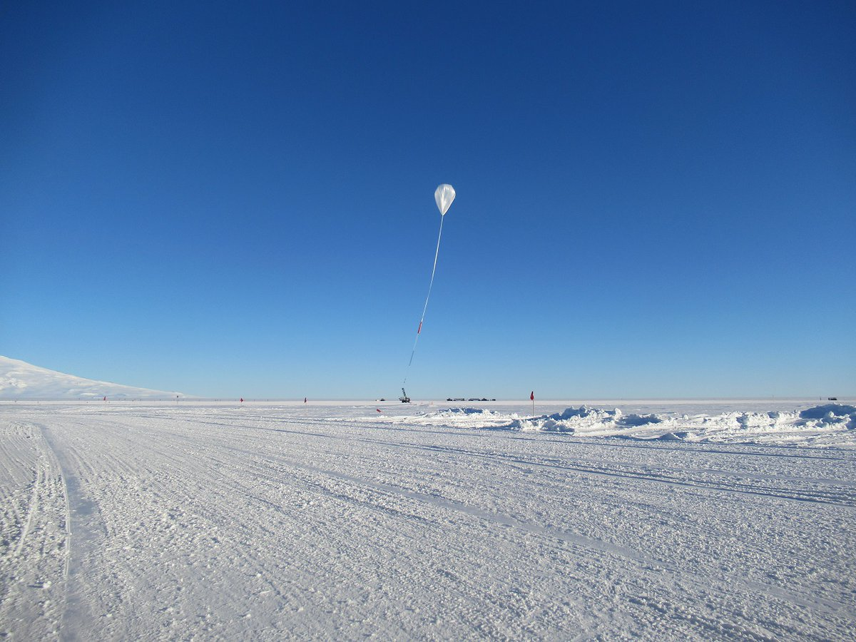
E-MIST project

Slide 5
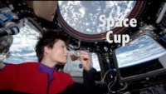

Slide 6
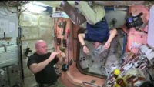

Slide 7
µTitan project-YNP

Slide 8
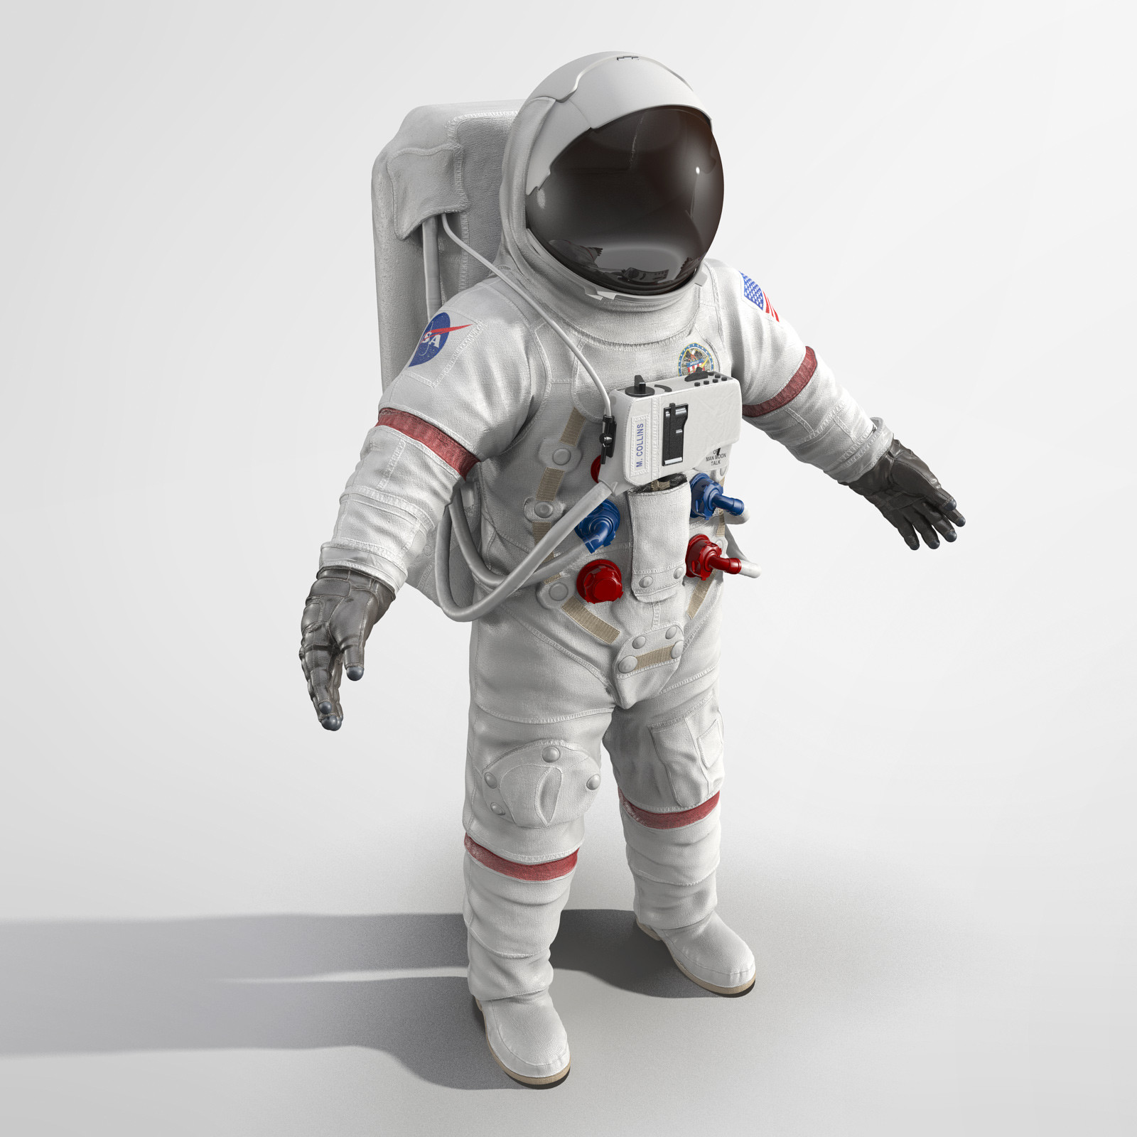

Microbial Tracking on the ISS
Astronaut swabs

Slide 9
Results: Horizontal gene transfer of AMR genes between Acinetobacter pittii (donor) and Staphylococcus aureus (recipient) is increased under SMG conditions compared to 1G

Slide 10
Results: Biofilm formation seems to be enhanced when S. aureus is grown under SMG compared to 1G

Slide 11
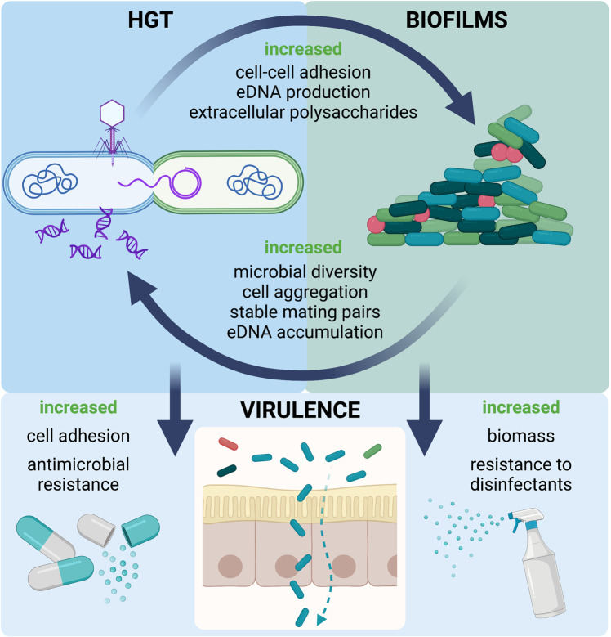
ODYSSEY Study: Outcomes of microbial dynamics during spaceflight and in simulated microgravity
One of NASA’s goals is to minimize the health risks associated with extended spaceflight, so it is critical that methods for preventing and treating spaceflight-induced illnesses be developed before astronauts embark upon long-duration space missions. In order to do so, it is important for NASA to learn how bacterial communities that play a role in human health and disease are affected by spaceflight.
Objective 1: Compare horizontal gene transfer efficiency between spaceflight, ground and Earth based microgravity analogs
Objective 2: Examine the properties of biofilm formation in space, and compare biofilm formation between spaceflight, ground, and Earth based microgravity analogs
Koehle AP, Brumwell SL, Seto EP, Lynch AM, Urbaniak C. Microbial applications for sustainable space exploration beyond low Earth orbit. NPJ Microgravity. 2023 Jun 21;9(1):47

Slide 12
Analysis
Samples will be prepared on Earth and loaded into hardware
Hardware will be stored at 4°C until launch
Samples will be grown at 37°C for 22 hours (Objective 1) or 52 hours (Objective 2) on the ISS
Samples will be processed and stored accordingly on the ISS until return to Earth, where analyses will take place
Analysis

Slide 13

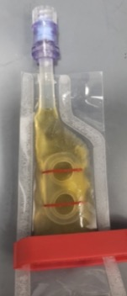
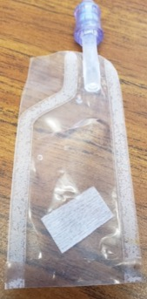
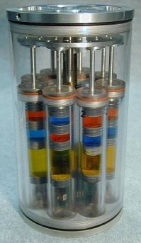
Spaceflight hardware
FEP bag with coverslip holders for microscopy
FEP bag with FEP-C coupon for transcriptomics/metabolomics
FPA (fluid processing apparatus) and GAP system

Slide 14
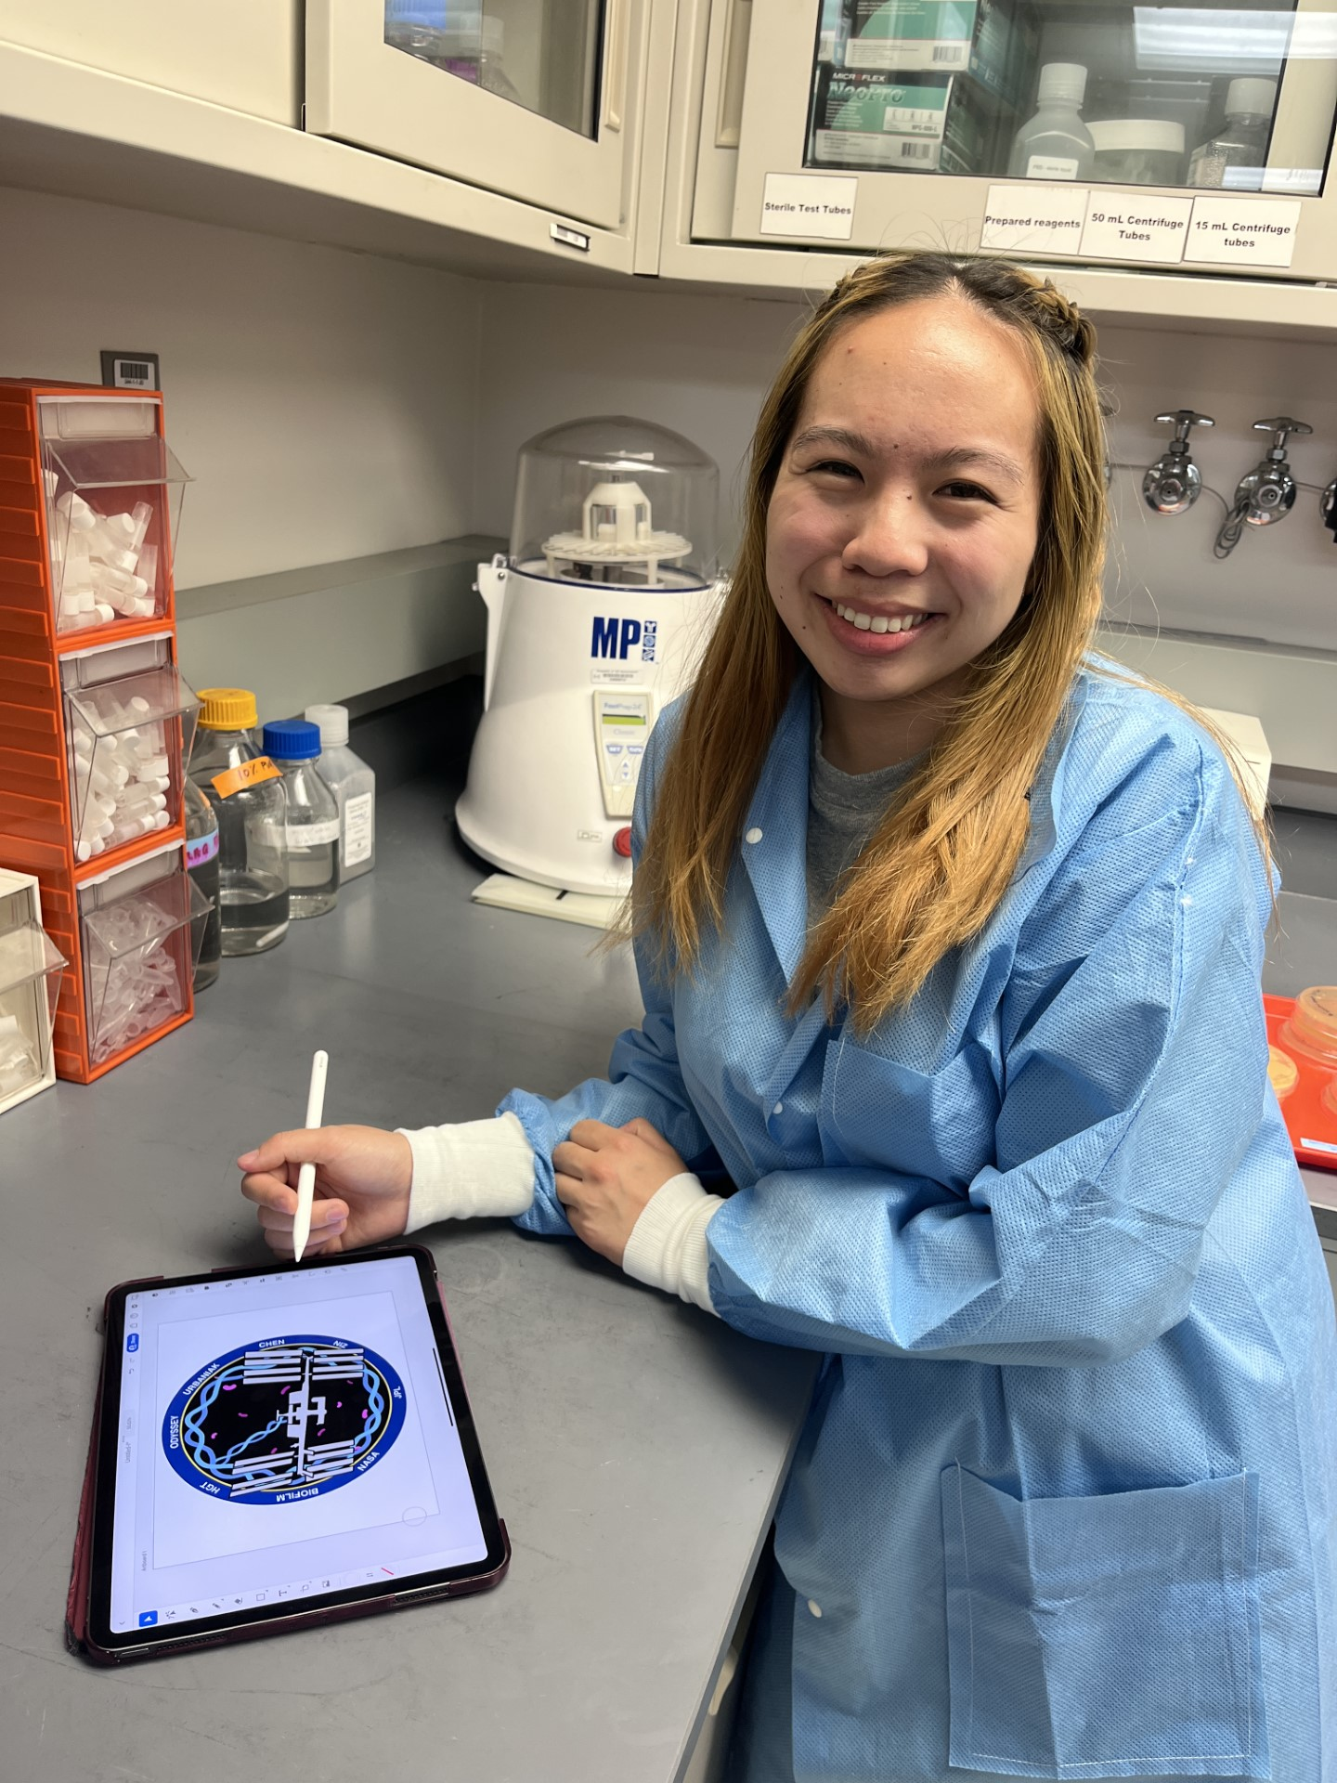
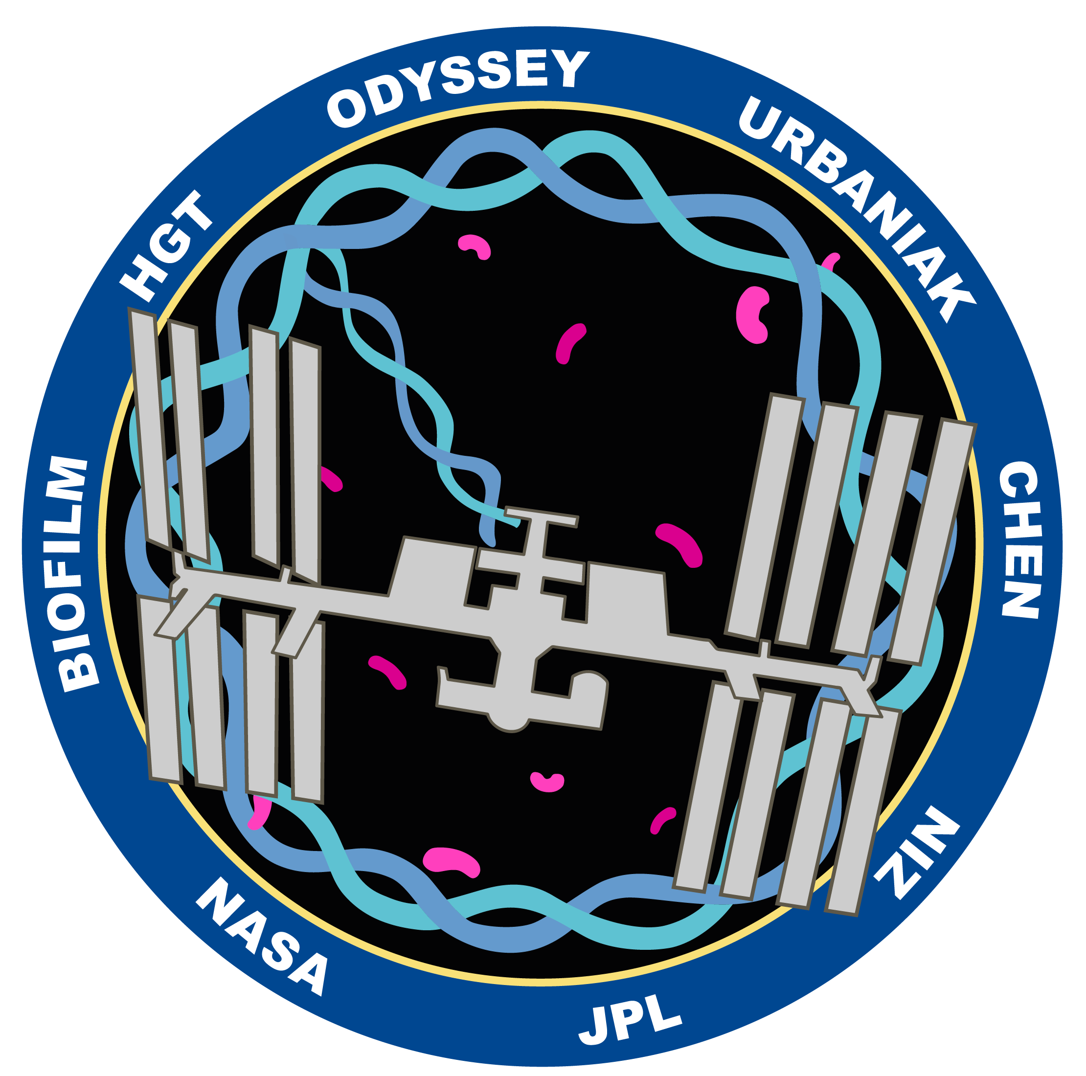




Dr. Laurent A. Bentolila
California NanoSystems Institute, CNSI, at UCLA
Dr. Mark Sumarah
Agriculture and Agri-Food Canada
Draft mission patch for ODYSSEY. Samples expected to be flown to the ISS in early 2024
Jaelin Chen, JPL Intern
UCLA undergrad in the Department of Microbiology, Immunology and Molecular Genetics
NASA Space Biology Program for funding this project
Dr. Stephanie Perreau-Rainey
Mission Scientist

Slide 15
