Slide 1
Institutional Core Facilities: Relationships with Users and Administration
Peter G. Barr-Gillespie, PhD
Chief Research Officer and Executive Vice President
Professor of Otolaryngology
Senior Scientist, Vollum Institute

Slide 2
The Barr-Gillespie lab studies hair cells
No, not the hair on your head! Hair cells of the ear.
Wait, no, not the hairs on your ear or in your ear canal, hair cells of the inner ear!
We are cell biologists and neuroscientists, and we use multiple cores at OHSU:
  Proteomics core
  Transgenic core
  Light microscopy core
  Electron microscopy core
  Virology core

Slide 3
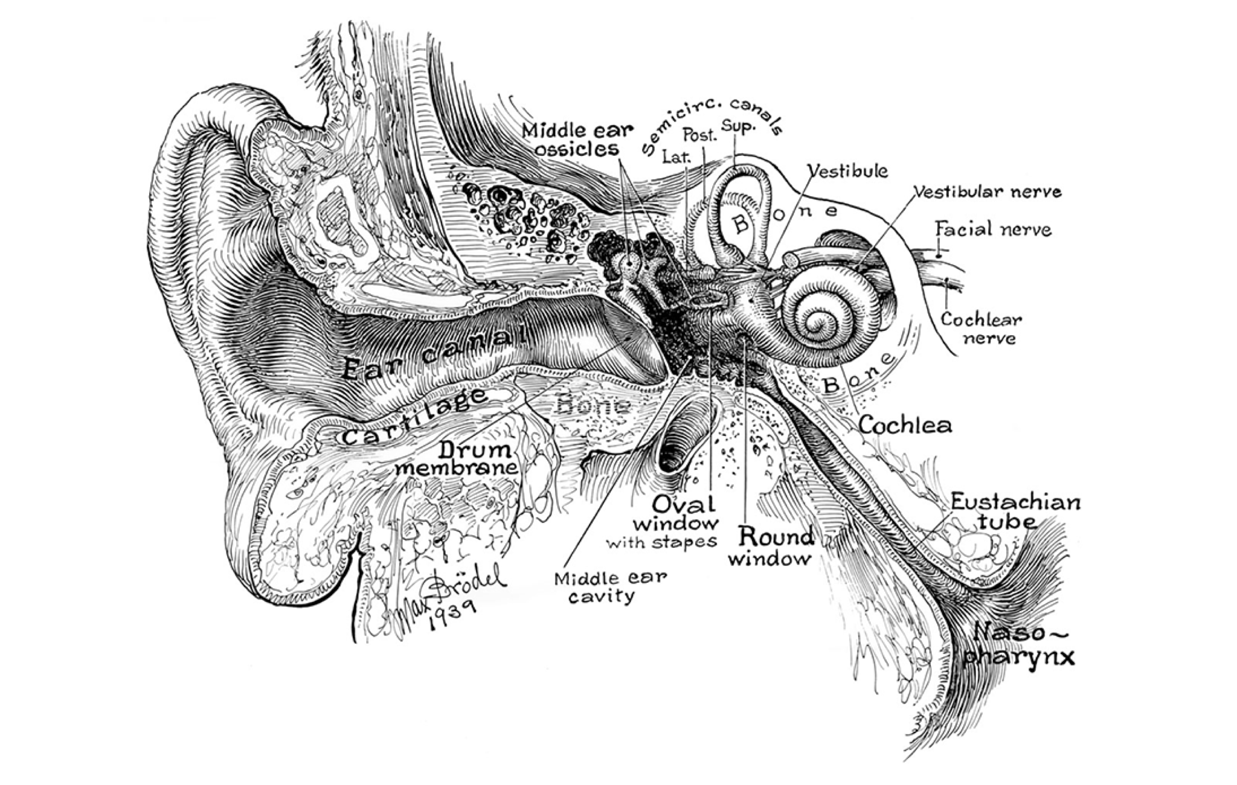
The ear

Slide 4
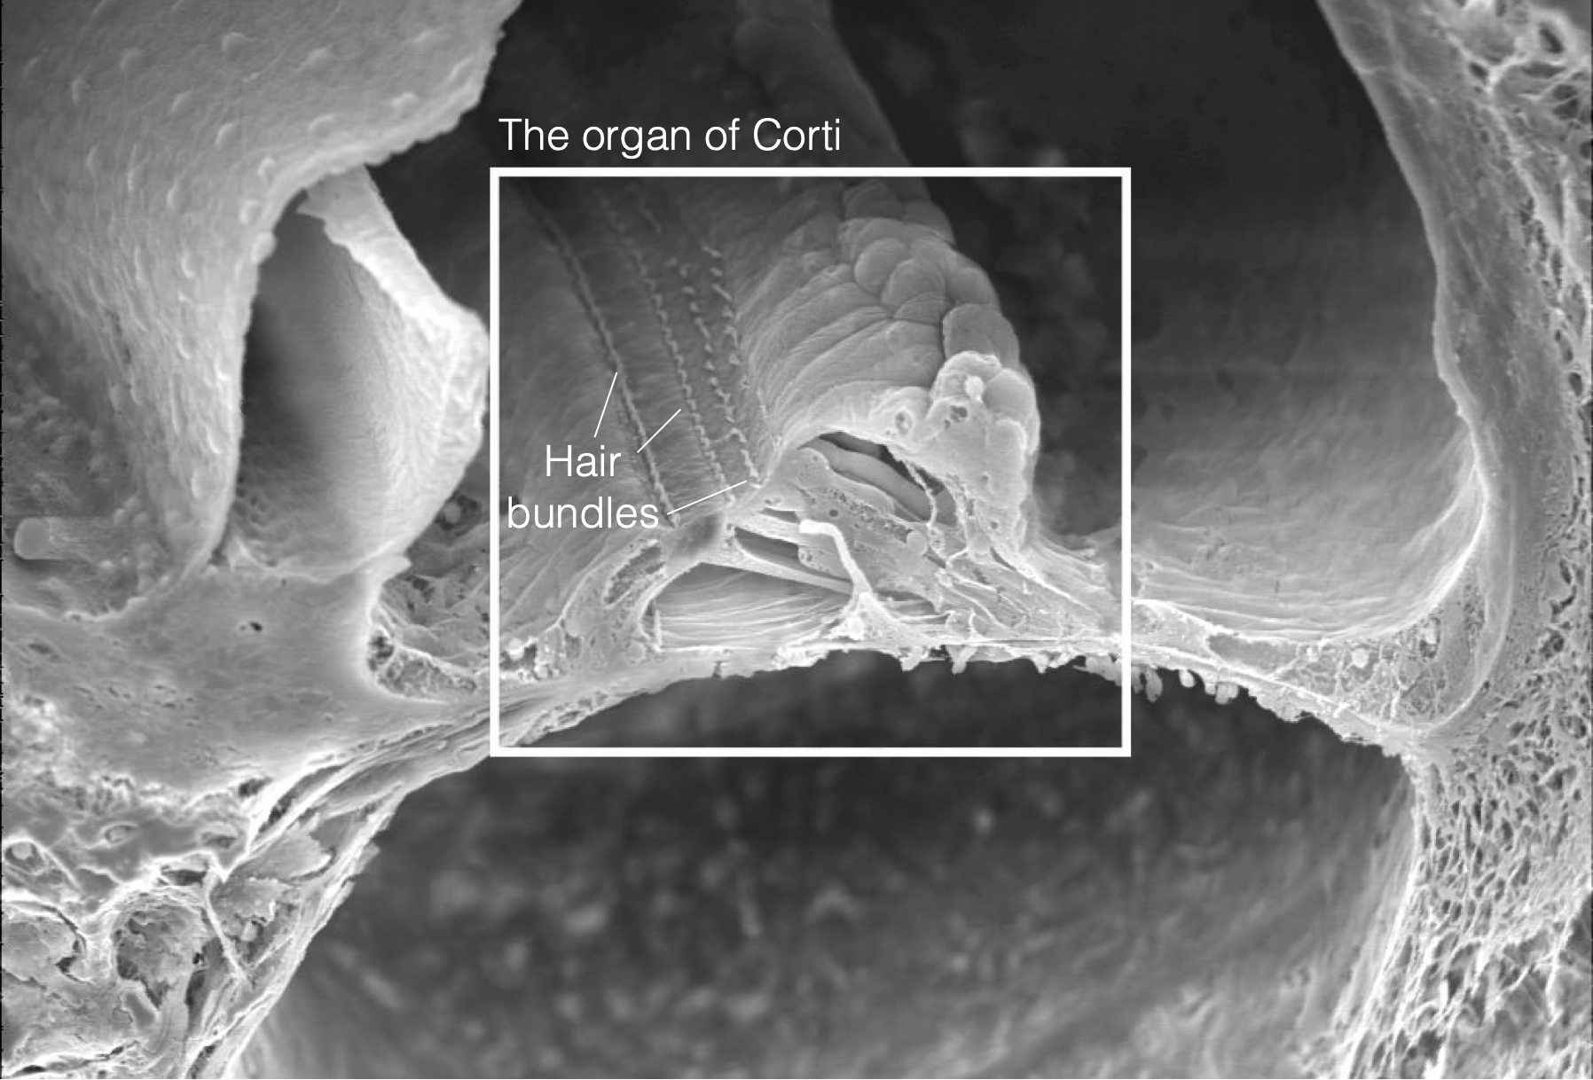
The inner ear

Slide 5
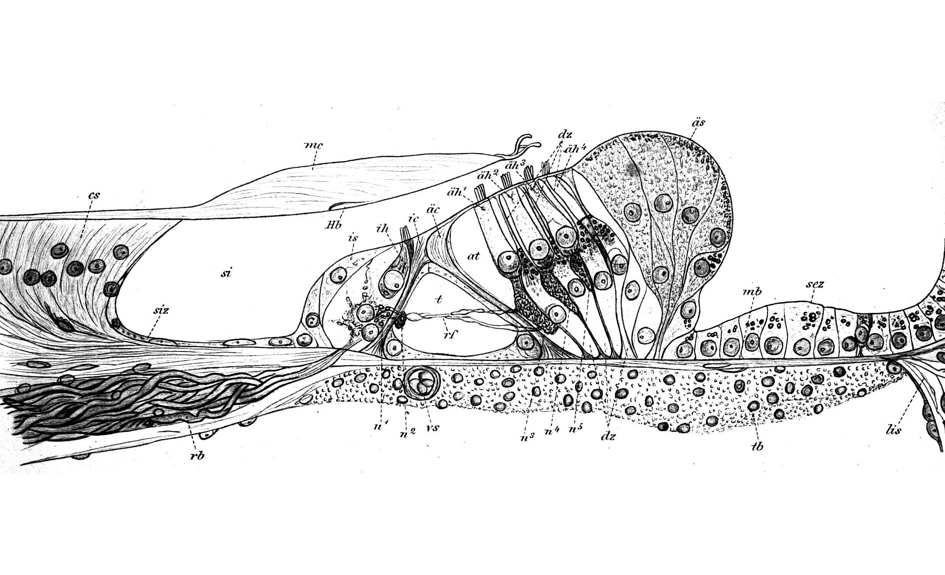
The organ of Corti

Slide 6
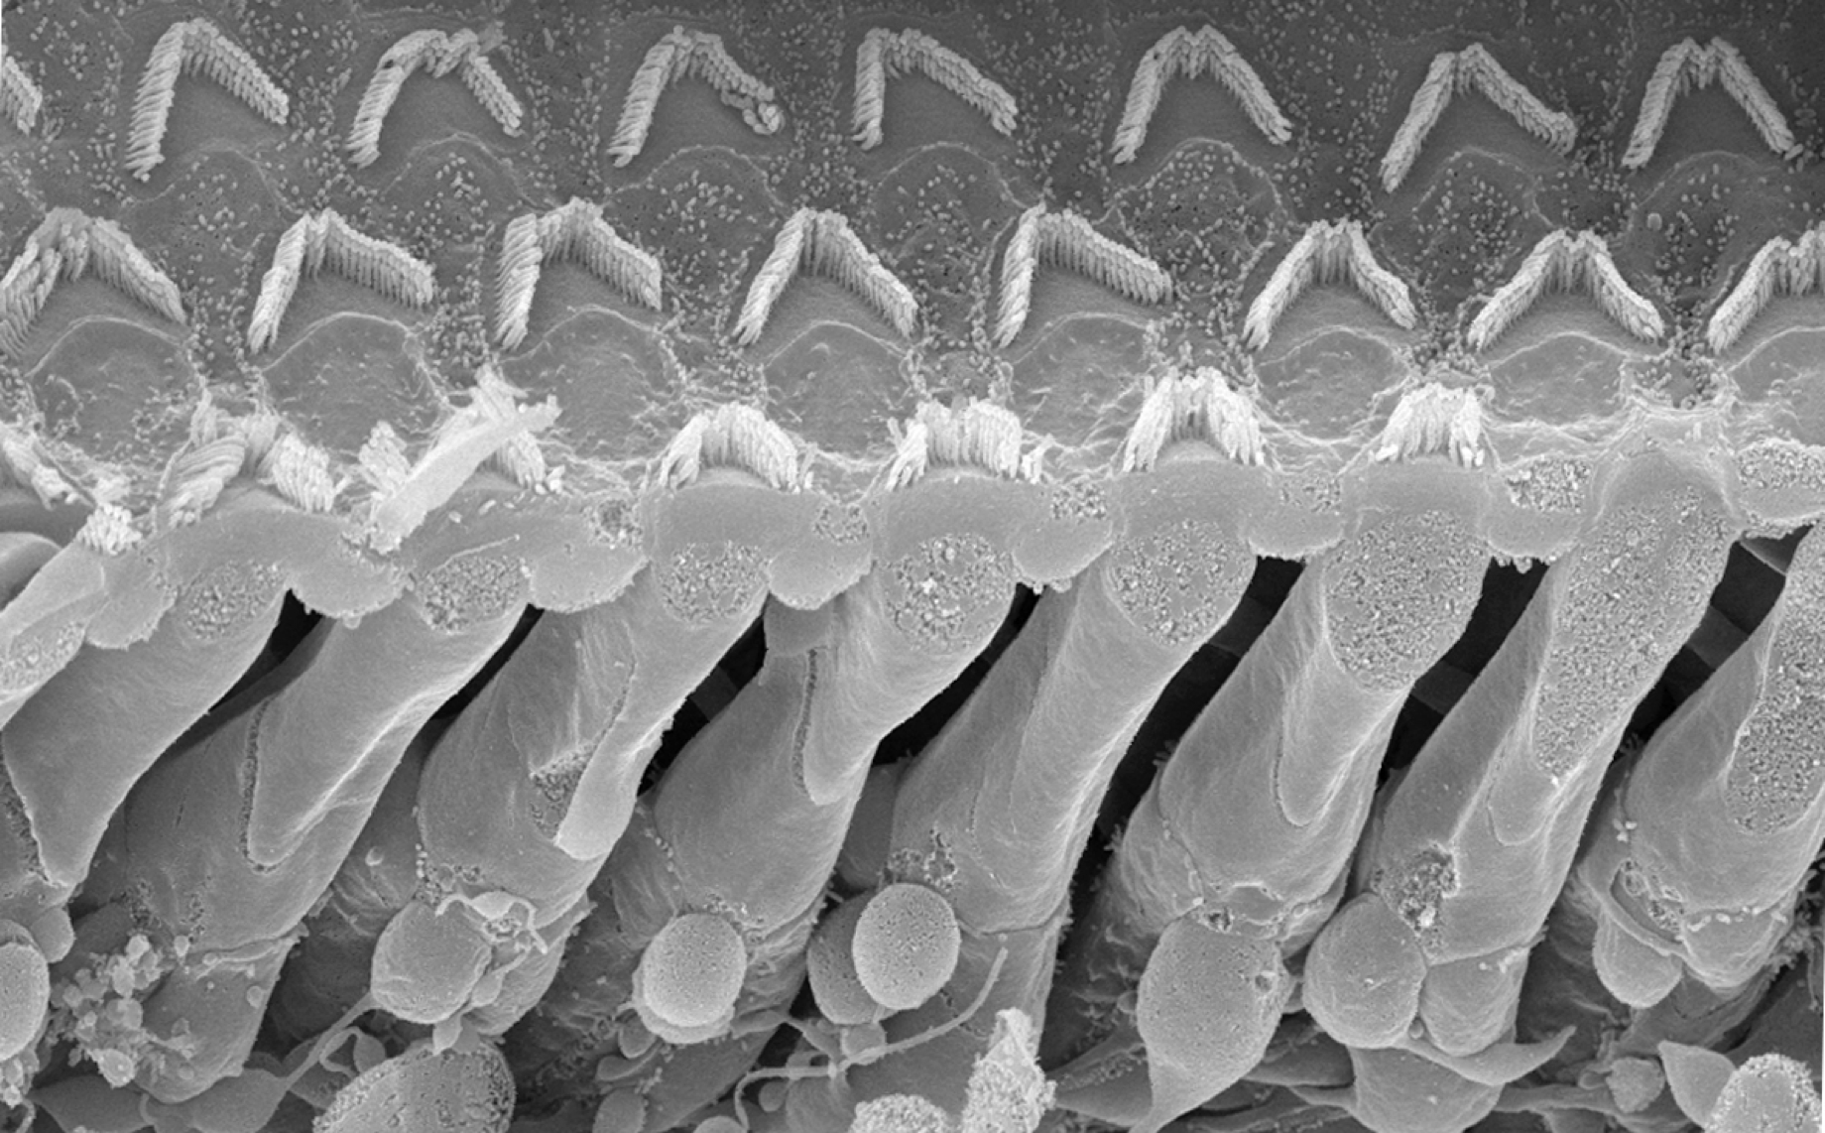
Cochlear hair cells

Slide 7
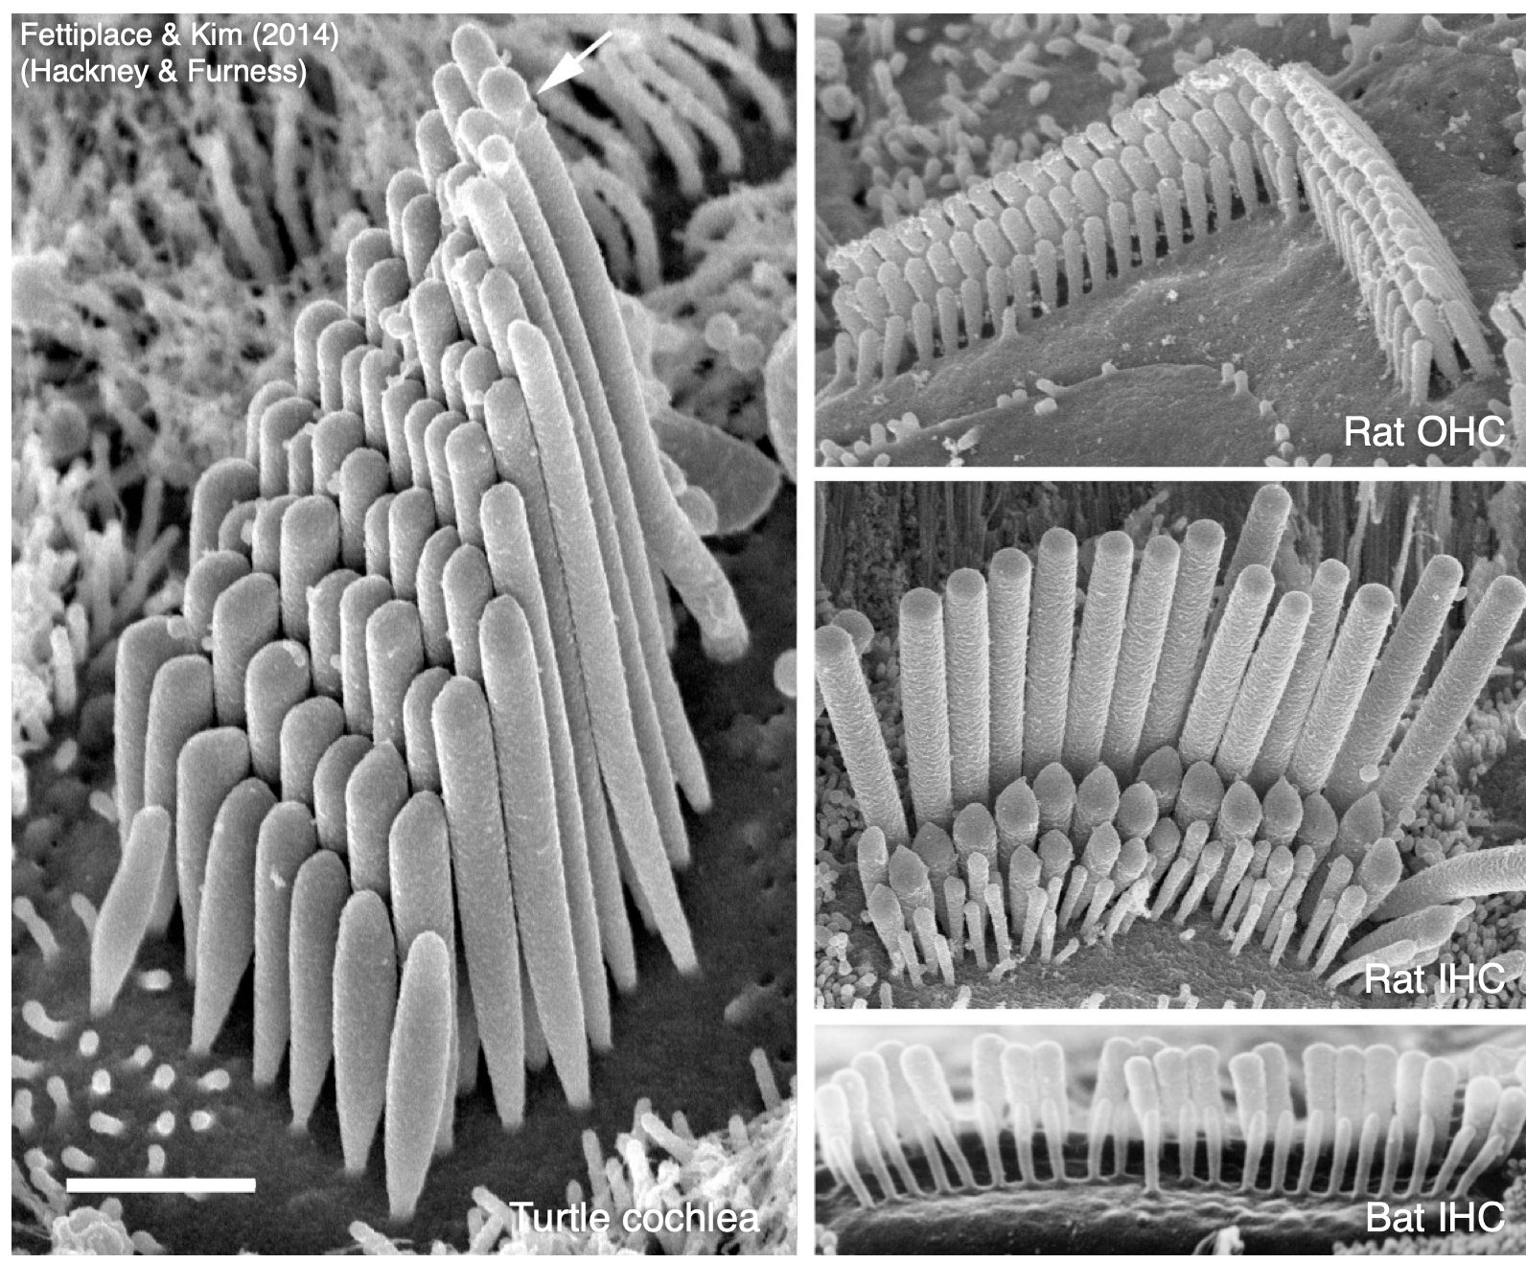
Hair bundles

Slide 8
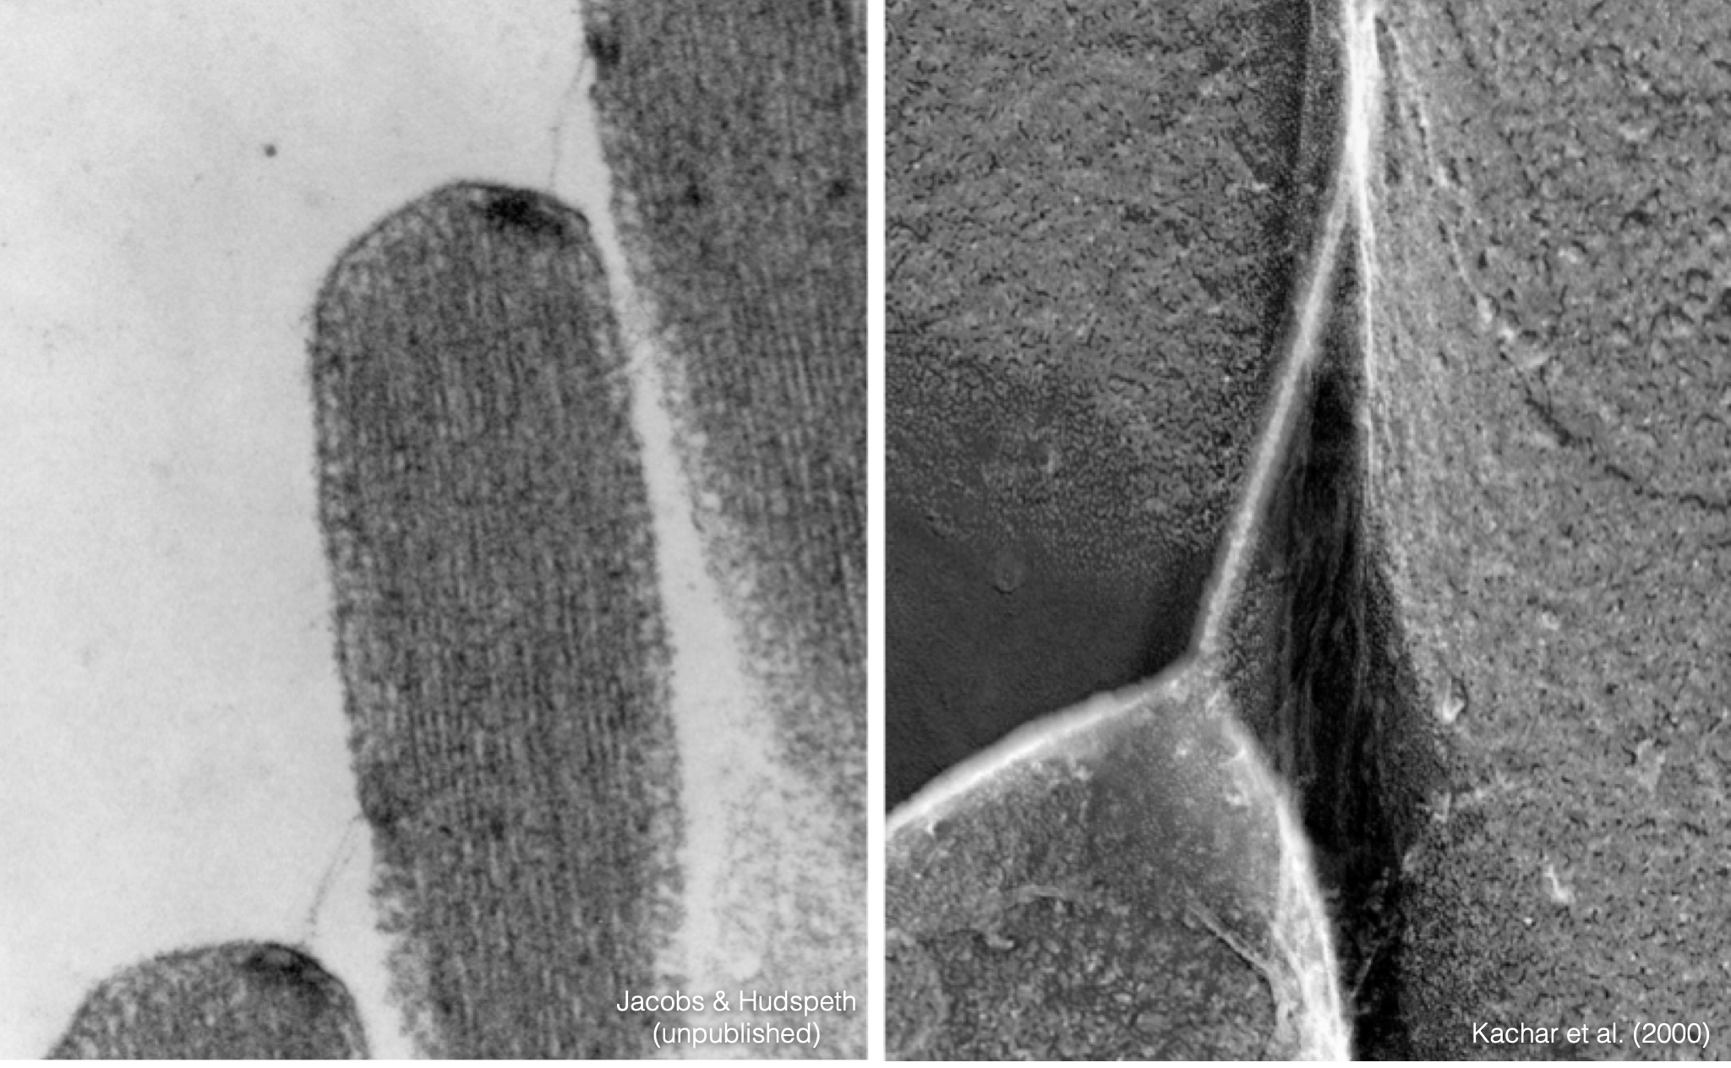
Tip links

Slide 9
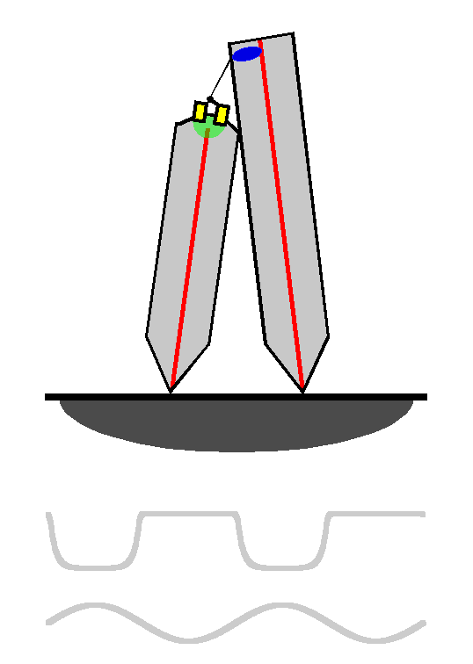
Transduction
Transduction current
Mechanical stimulus

Slide 10
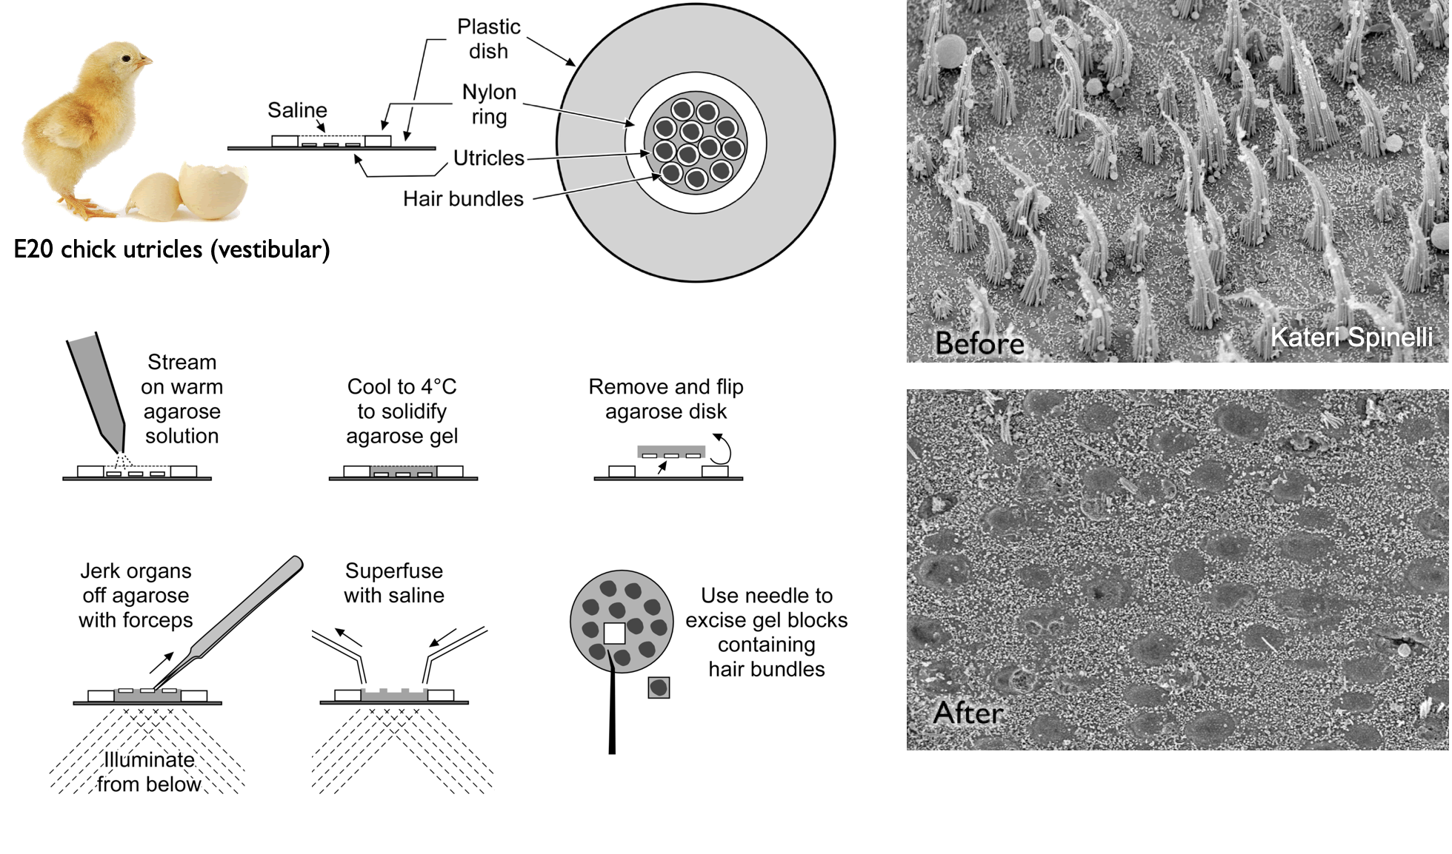
Isolated hair bundles

Slide 11
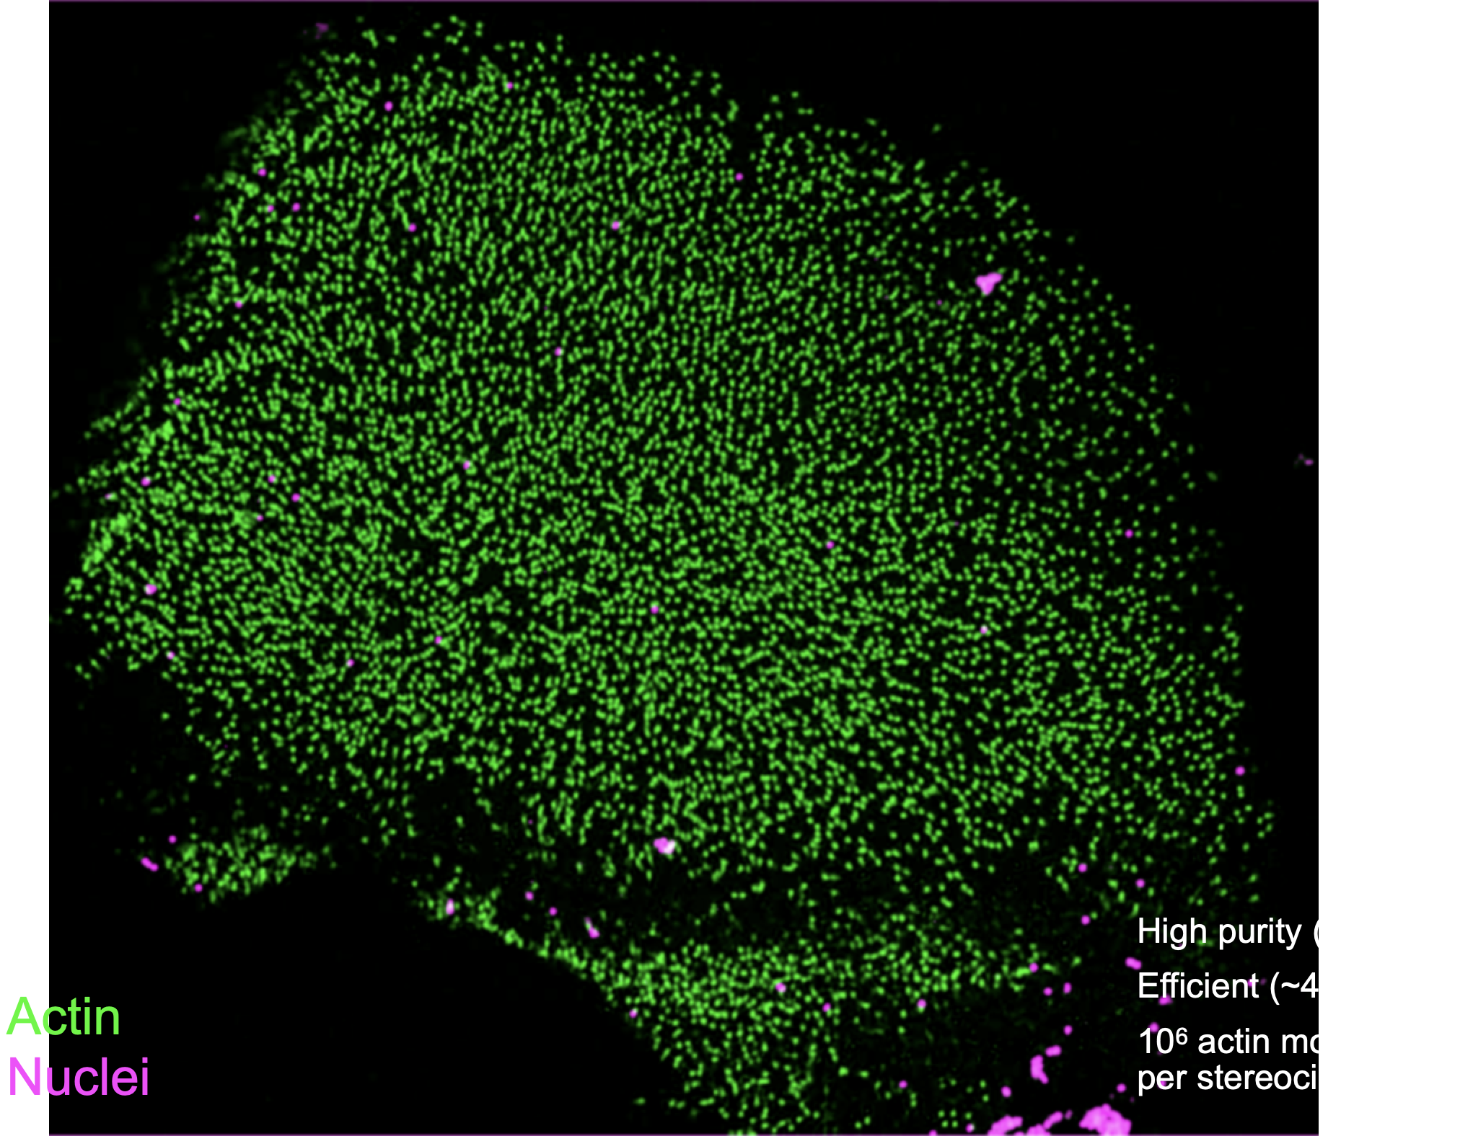
Isolated hair bundles
Proteomics core
for analysis of hair-
bundle proteins

Slide 12
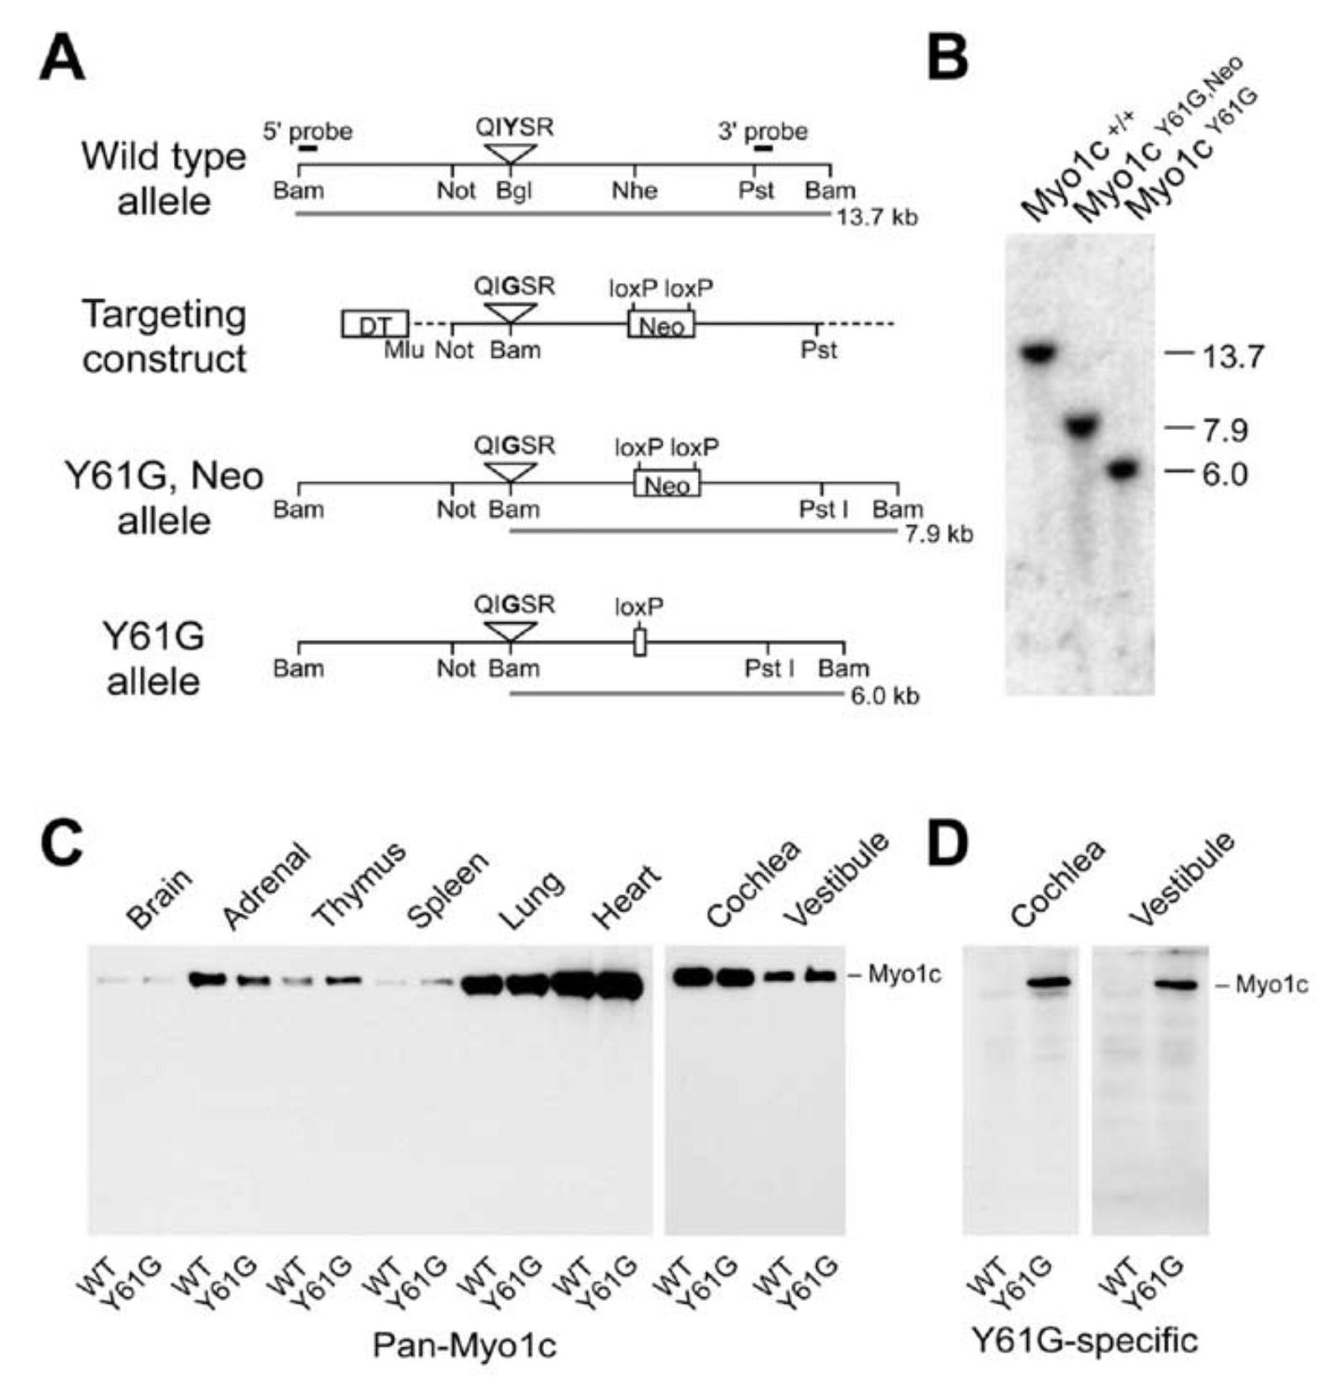
Knock-in of sensitizing mutation at
Myo1c locus
Transgenics
core

Slide 13
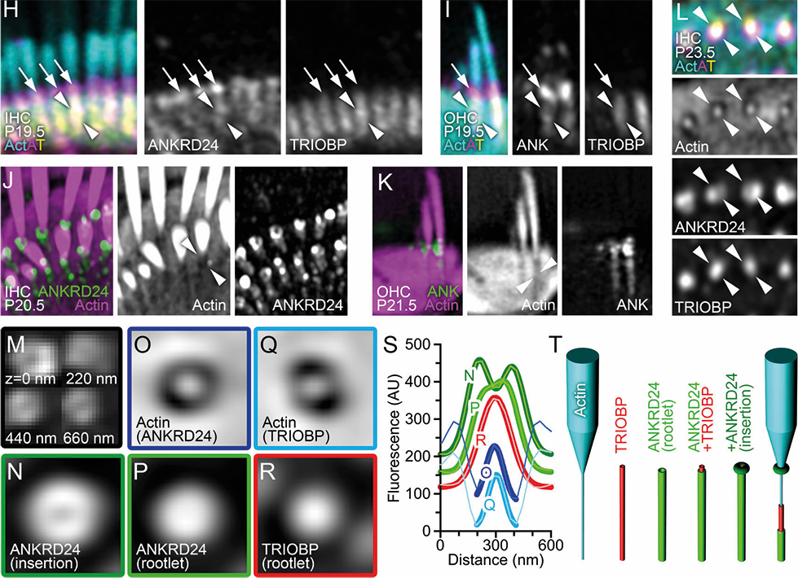
Super-resolution light micro- scopy
Light micro-
scopy core

Slide 14
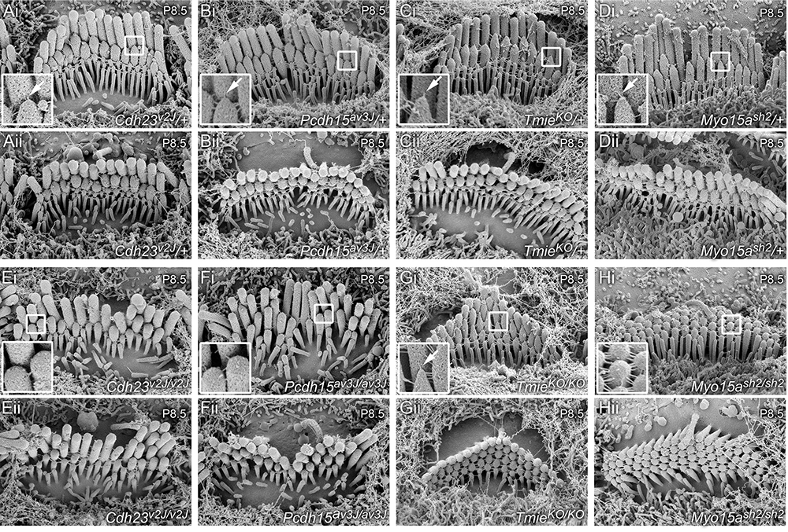
Scanning
EM
Electron
micro-
scopy
core

Slide 15
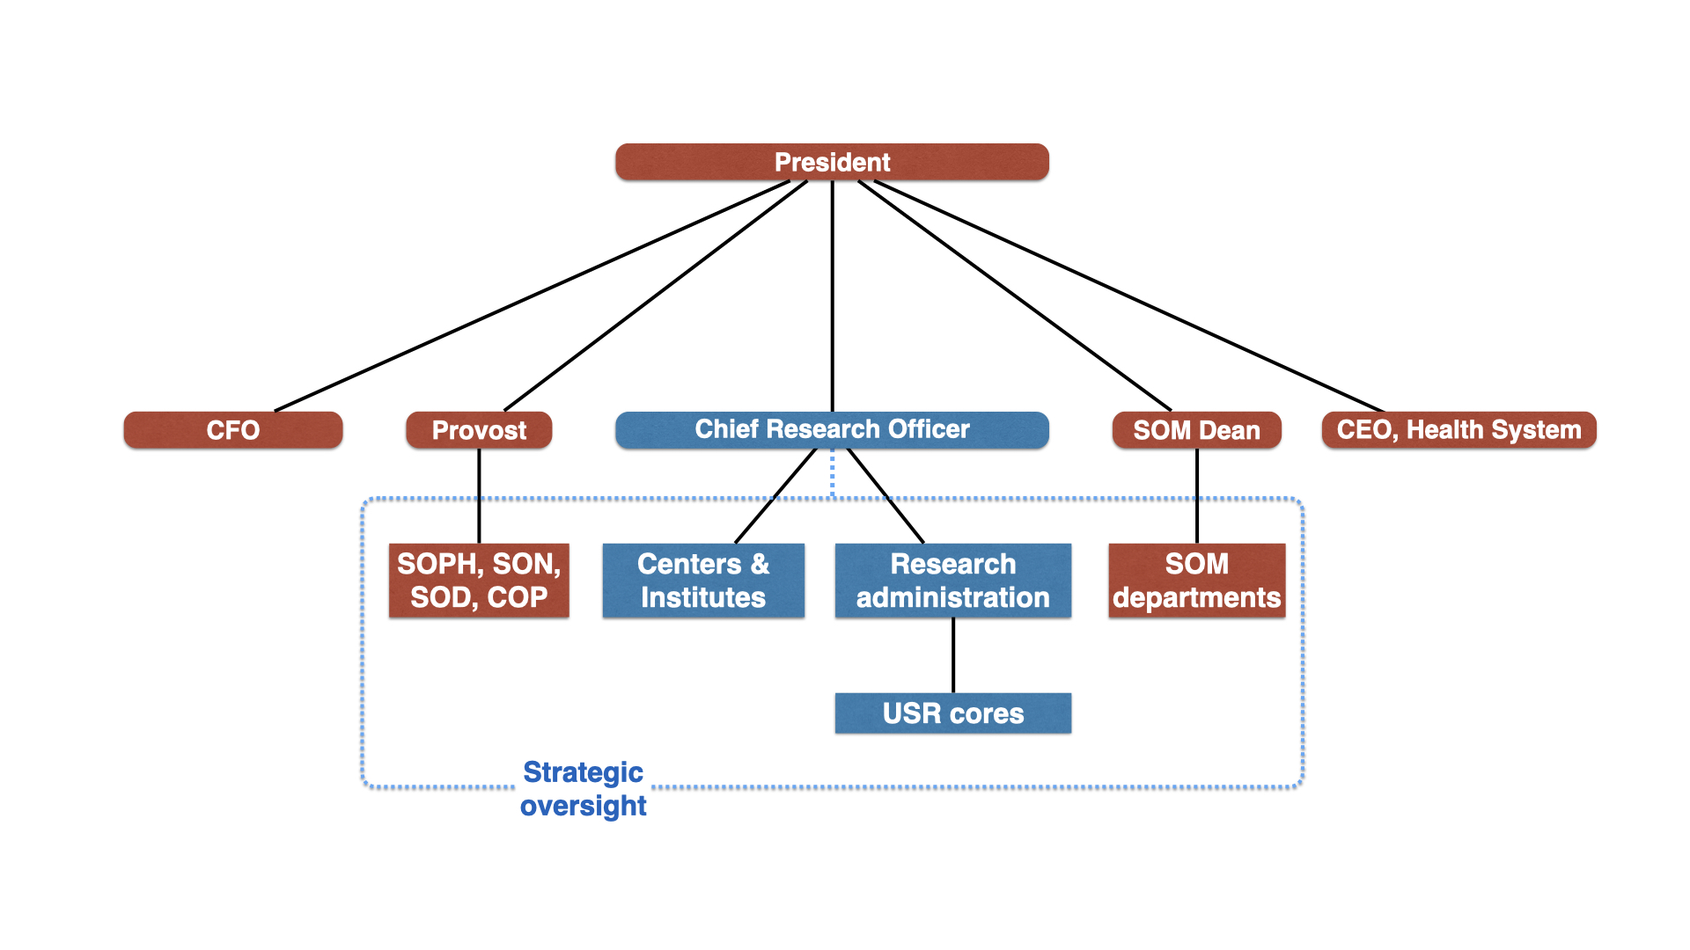
CRO roles and responsibilities

Slide 16
The OHSU University Shared Resources (USR) program
USR program has been going for ~15 years
  Access to all instrumentation for all OHSU members
  Partially subsidized rates (but some PIs still think rates are too high)
  Slow modernization of instrumentation when possible
  Pilot program periodically offered
Topics for today
  Organization and management
  Financial support
  Relationships with the faculty
  Communications, especially with research administration

Slide 17
Organization and management
Organization
  Andy Chitty, Program Director
  Reports up through Research Finance to CRO
  Core Oversight Committee (still paused since COVID)
  AVP Basic Science is the Scientific Advisor (position currently vacant)
Core Directors meet regularly with Andy Chitty
Each core has their own faculty oversight committee
Stefanie Kaech Petrie (ALM) serves as interim Scientific Advisor

Slide 18
USR org chart

Slide 19
USR finances
Financial support
  Cores bring in 25-90% of expenses with recharges
  Significant ongoing institutional commitment to cover remainder
  Includes ~$700k per year for instrumentation
  CRO office is prepared to contribute matching funds for instrumentation grants—being shared in a USR core is a major positive
Pilot program
  On hold because of OHSU financial status
  Offered $5k-$10k to be used in a USR core
  Very popular—competitive

Slide 20
The big financial picture

Slide 21
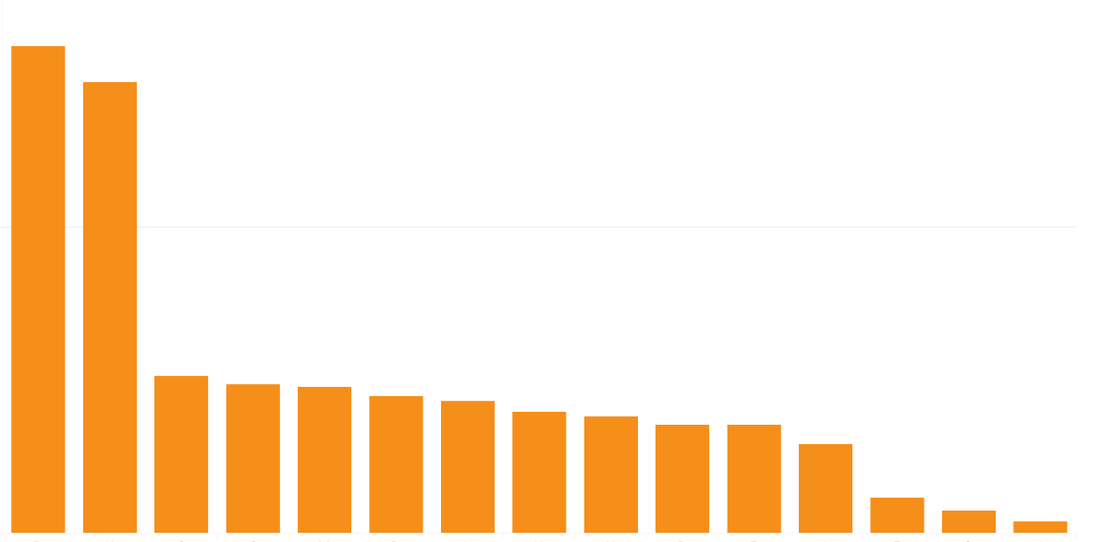
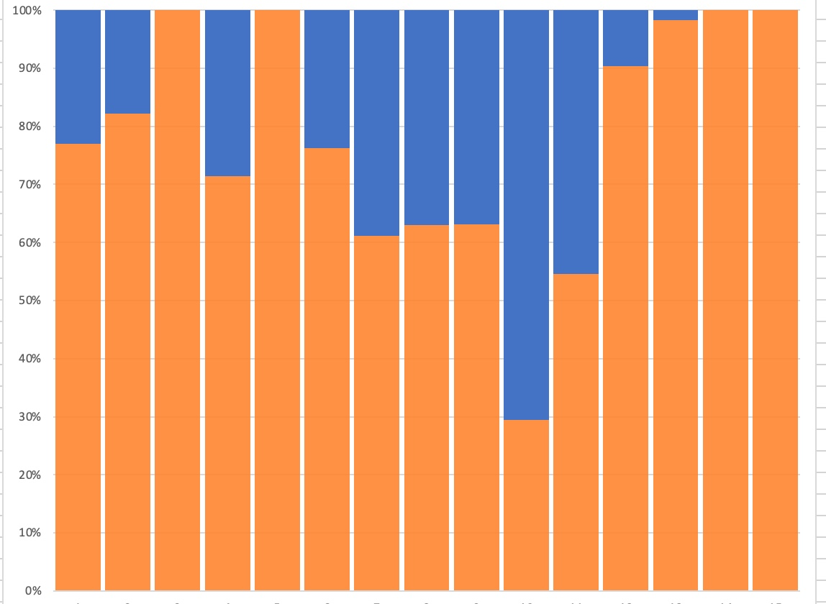
Cost recovery and subsidization
Annual expenses
Operations expenses vary widely by core:
Size of operations
Type of technology
Cost recovery varies by core:
Price ceilings (costs to researchers)
OHSU technological priorities
Economies of scale
% revenue / % USR support

Slide 22
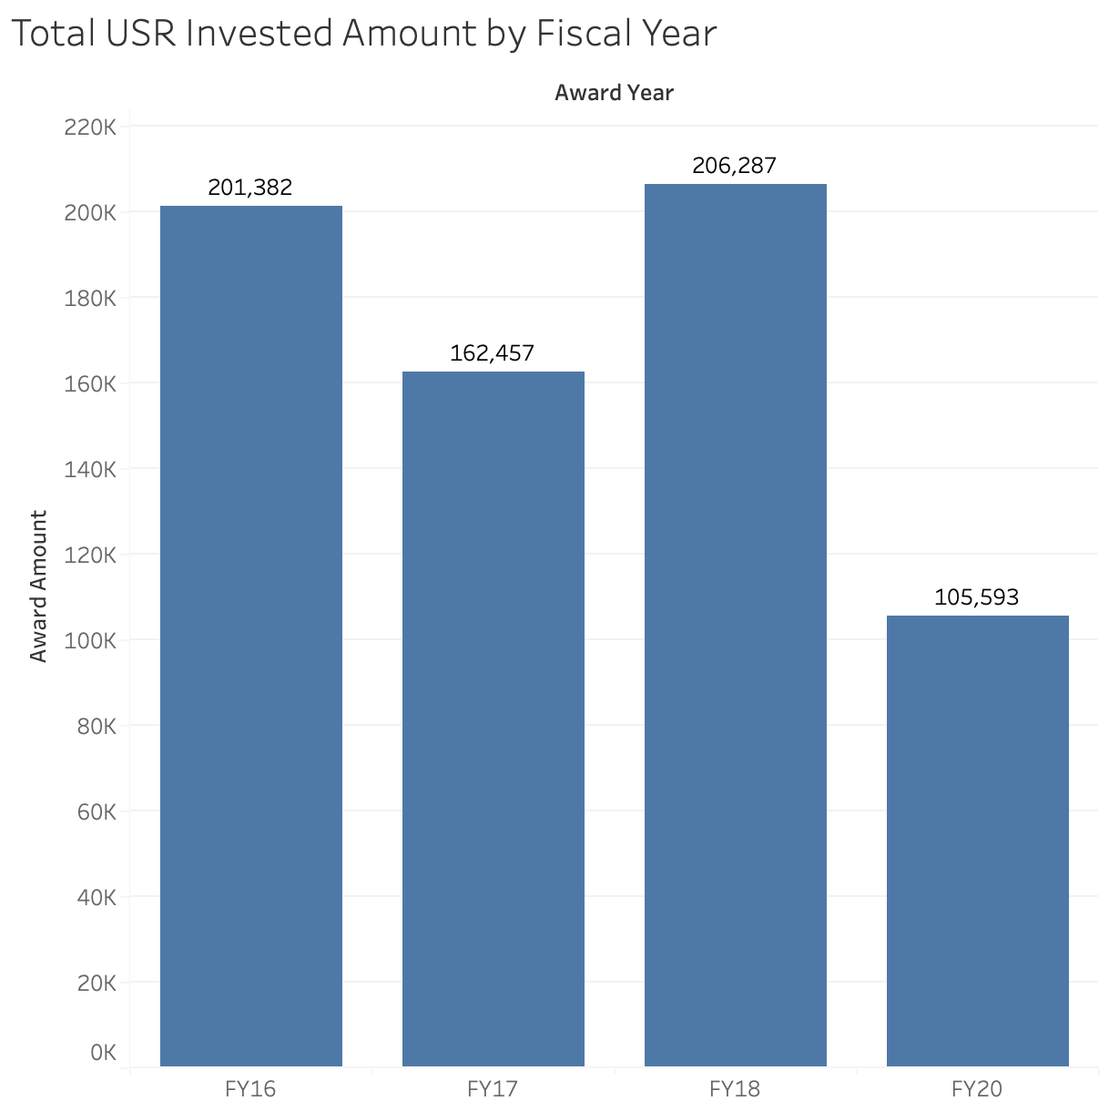
Pilot awards
Acquisition of pilot data
Method development
Method validation
Award Year
FY16 - $201,382
FY17 - $162,457
FY18 - $206,287
FY20 - $105,593
86 total awards

Slide 23
Relationships with faculty
Faculty can participate in Core Advisory Committees
Periodic surveys
As noted before, some faculty think that “the cores are too expensive”
Particularly difficult for junior investigators
Rate subsidies would be nice, but (a) they are difficult to implement while following NIH rate rules, and (b) they are expensive

Slide 24
Communications
How can core leaders best communicate with you to make sure we are giving you the information you need and address any concerns on all sides? Is there a style, approach, or format you and other research leaders can imagine that would work best, especially given the scarcity of available time?
You have to juggle a lot of objectives that may be competing - scientific needs, finances, investments, research priorities, etc. How can we be of help to you in this?
With all the things you have going, are there items we take off your plate? What are items that you’ll always want on your plate, and are there ways we can make the process easier and/or more effective?
As CRO, you know what cores are, what they do, and why they are important to an institution. Other executive leaders in the institution may not have that same perspective. If appropriate, do you have thoughts on how to communicate about our contribution to other institutional leaders?
Do you think your leadership style is different or similar to others in similar positions? Is there a sort of typical CRO leadership model, and if so, how do you think you fit into that model?
Please introduce any other topics you find important around communication. It will be valuable to hear your perspective.

Slide 25
More questions?
Thanks for listening!

